Slide 1
ALIYO
It’s like Google for SMS

Slide 2
IMAGINE
Being able to search the web without
using your carrier data.

Slide 3
Accessing the internet anytime, anywhere
without the need to worry about data
limits or fees.

Slide 4
Our Goal

Slide 5
Make the internet
searchable & interactive
through SMS/MMS.

Slide 6
We are going to achieve this goal
by storing internet content on our
platform & delivering it through
MMS/SMS upon request.
(Directives, Links, Photos, Videos, & Audio)

Slide 7
Why?

Slide 8
Texting uses virtually no carrier data & texting
will allow us to achieve a new height in
web continuity.

Slide 9
So Without Further Ado!

Slide 10
MEET ALIYO
It’s like Google for SMS

Slide 11


Slide 12
You can test ALIYO right now by texting
“Aliyo:test” to (201) 879-6938.

Slide 13
The text that you just sent & received cost us
less than a penny.

Slide 14
ALIYO is a search engine that can receive
a query via SMS, search through it’s index
and send an appropriate response back
via SMS.

Slide 15
HOW IT WORKS
OUTPUT = Website + Command

Slide 16
ALIYO gives users the ability to search
through individual apps/sites
using commands.
Example: if you want to search Rap Genius for
lyrics to the song One Dance just text ALIYO
“Genius: One dance”

Slide 17
Genius: The way you look should be a sin you my sensation
Game of Thrones:
Season 6
Kanye’s girl’s sexiness tempts him with sinful thoughts, leading him to believe that dressing so evocatively and looking so good should be a sin itself. In church people raise their hands to praise God, and ‘Ye implies this might be the best thing to do when you see a girl as beautiful as her.
Here are all the episodes in Season 6.
You can get more info about any episode listed by saying the title of the episode.
ex. “No One”
EP 1: The Red Woman
EP 2: Home
EP 3: OathBreaker
EP 4: Book of Stranger
EP 5: The Door
EP 6: Blood of my Blood
EP 7: The Broken Man
EP 8: No One

Slide 18
CONTINUITY!

Slide 19
A huge strength to being able to search individual
apps/sites is the ability to achieve
NESTED SEARCHES.

Slide 20
ALIYO CAN HAND-OFF INFORMATION COLLECTED
FROM ONE SITE IN ORDER TO USE IT
IN ANOTHER SITE OR APP.

Slide 21
HOW IT WORKS
OUTPUT = Website + Command + OUTPUT = Website + Command
An example of this would be if you asked the Shazam App
to find the title of a song currently playing. Shazam finds
the title of the song, then automatically searches the
title of the song using Genius.
ALIYO will return the title of the song using Shazam
and return the lyrics of the song using Genius.

Slide 22
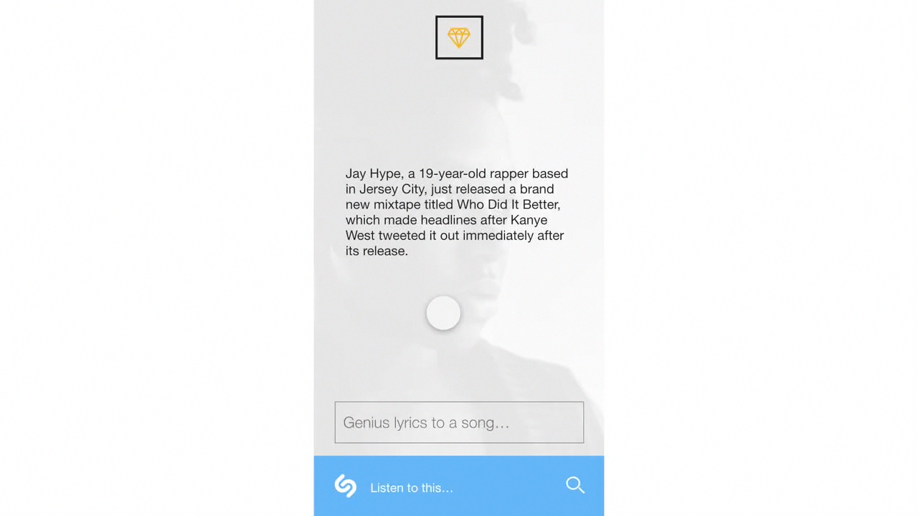

Slide 23
CONTINUITY + REFERAL MARKETING
The ALIYO BUSINESS MODEL

Slide 24
A major objective that we have with continuity
is giving companies the ability to connect the
main function of their application with the
main function of another application.

Slide 25
IT IS KINDA LIKE THE GAME JENGA

Slide 26
Functions refer other functions
A FUNCTION BUILDS ON ANOTHER FUNCTION
RECIPE FOR COOKIES
BUY THE INGREDIENTS FOR RECIPE
LISTEN TO BAKING PLAYLIST
MAKE MOVE ON CANDY CRUSH WHILE COOKIES ARE BAKING
SHARE PICTURE OF COOKIES ON FACEBOOK

Slide 27
If ALIYO thinks your function can appropriately
build off of the function that a person
is currently using it will refer your
function at the bottom.

Slide 28
WE CHARGE $1PER CLICK

Slide 29
And we will refer functions to
apps so that companies
can make money too!

Slide 30
It is super easy to setup referrals. A user can
upload text, photos, and audio to a card.
Set a main command and connect that
command to other commands

Slide 31
INTRODUCING

Slide 32
THE CARD
ALIYO
COMPANY NAME
Metro
Add Your First Response
COMMAND
Metro
Report
Post

Slide 33
THE BIG PICTURE!

Slide 34
DAWN OF THE PLANET
MOBILE FIRST

Slide 35
MOBILE FIRST
This Is The New Frontier of INFORMATION
P
MMS
PHONE
—2.6B Cellphones Globally (2016)

Slide 36
MOBILE FIRST
This Is The New Frontier of INFORMATION
MMS
W
Wearables
—155.7M Wearables Globally (2018)

Slide 37
More Mobile = More Data

Slide 38
Mo Data. Mo Problems.
The cost for data is rising
2016
unlimited data
2013
unlimited data
$82.50
2010
unlimited data
$75.00
$29.99

Slide 39
WHY IS DATA SO EXPENSIVE?

Slide 40
An article by The Atlantic put it best.
“Limited competition, infrastructure that’s costly to build,
growing demand for services, and only a sliver of
spectrum availability”

Slide 41
ALIYO = MORE MOBILE LESS DATA

Slide 42
LESS DATA = LESS MONEY

Slide 43
WE WANT THE WORLD TO…

Slide 44
KEEP CALM
&
ENJOY UNLIMITED CONNECTION

Slide 45
WHAT WE HAVE ALREADY ACCOMPLISHED.
—RAISING $1,500 FROM FAMILY FRIENDS
—BUILDING AN APPLICATION THAT CAN RECEIVE, SEARCH, & SEND
—DESIGNING A UI & CLICKABLE PROTOTYPE
—SHARING OUR CONCEPT & VALIDATING
USERS
RESULTS (1.5 MONTH)

Slide 46
WHAT WE NEED TO
ACCOMPLISH
—HIRING A DEVELOPER AND EXPANDING
OUR ADVISORY TEAM — PLEASE JOIN
—CONNECTING OUR APPLICATION
TO A USER INTERFACE — REQUESTED WHEN USER TESTING ALIYO
—CONNECTING OUR DATABASE TO A USER INTERFACE. - $500 QUOTE FROM DEVELOPER LOOKING FOR INVESTMENT
—ADDING A GLOBAL SEARCH FUNCTION
TO OUR APPLICATION
—ADDING MMS TO OUR APPLICATION - $500 QUOTE FROM DEVELOPER LOOKING FOR INVESTMENT
—LAUNCHING A PUBLIC BETA FOR TESTING

Slide 47



OUR TEAM
CHIEF ARCHITECT
Christopher Reed
CHIEF ARCHITECT
Michaelangelo Hayes
CHIEF ARCHITECT
Aaron Brown
CHIEF ARCHITECT
Delmar Patterson
CHIEF ARCHITECT
Christopher Schott
ADVISOR
Daniel Miller
STAND-IN DEVELOPER
Evgeny Rozhnov

Slide 48
OUR COMPETITION
No search engine, No continuity
—COSMOS BROWSER
TWILIO
SMSmart
DUKE UNIVERSITY STUDENTS

Slide 49
Thank You For Your Time!
Call 202-904-9398 for more information
or send us an email at info@aliyo.space

